Slide 1
Learning to Aggregate on Structured Data
Master Thesis Final Presentation
Clemens Damke

Slide 2
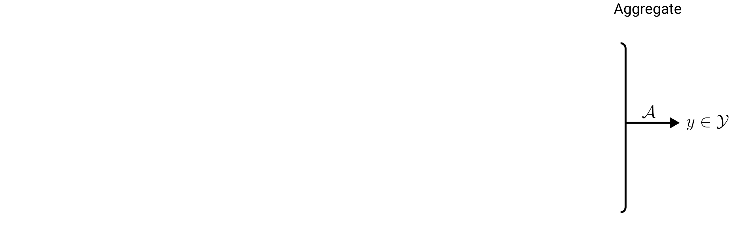

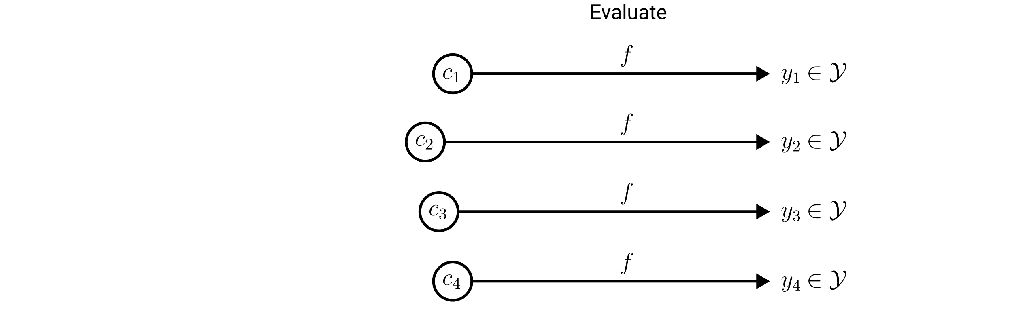
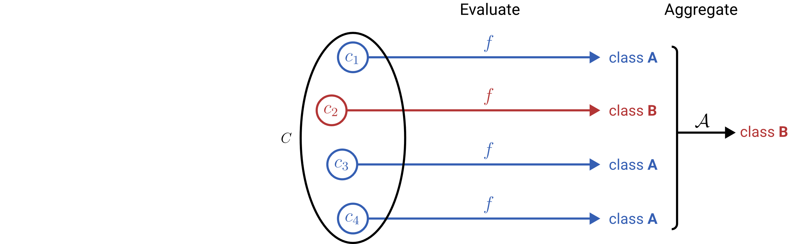
Learning to Aggregate on Unstructured Data
Permutation invariance
Variable input size
Localized explainability
composition
constituent

Slide 3
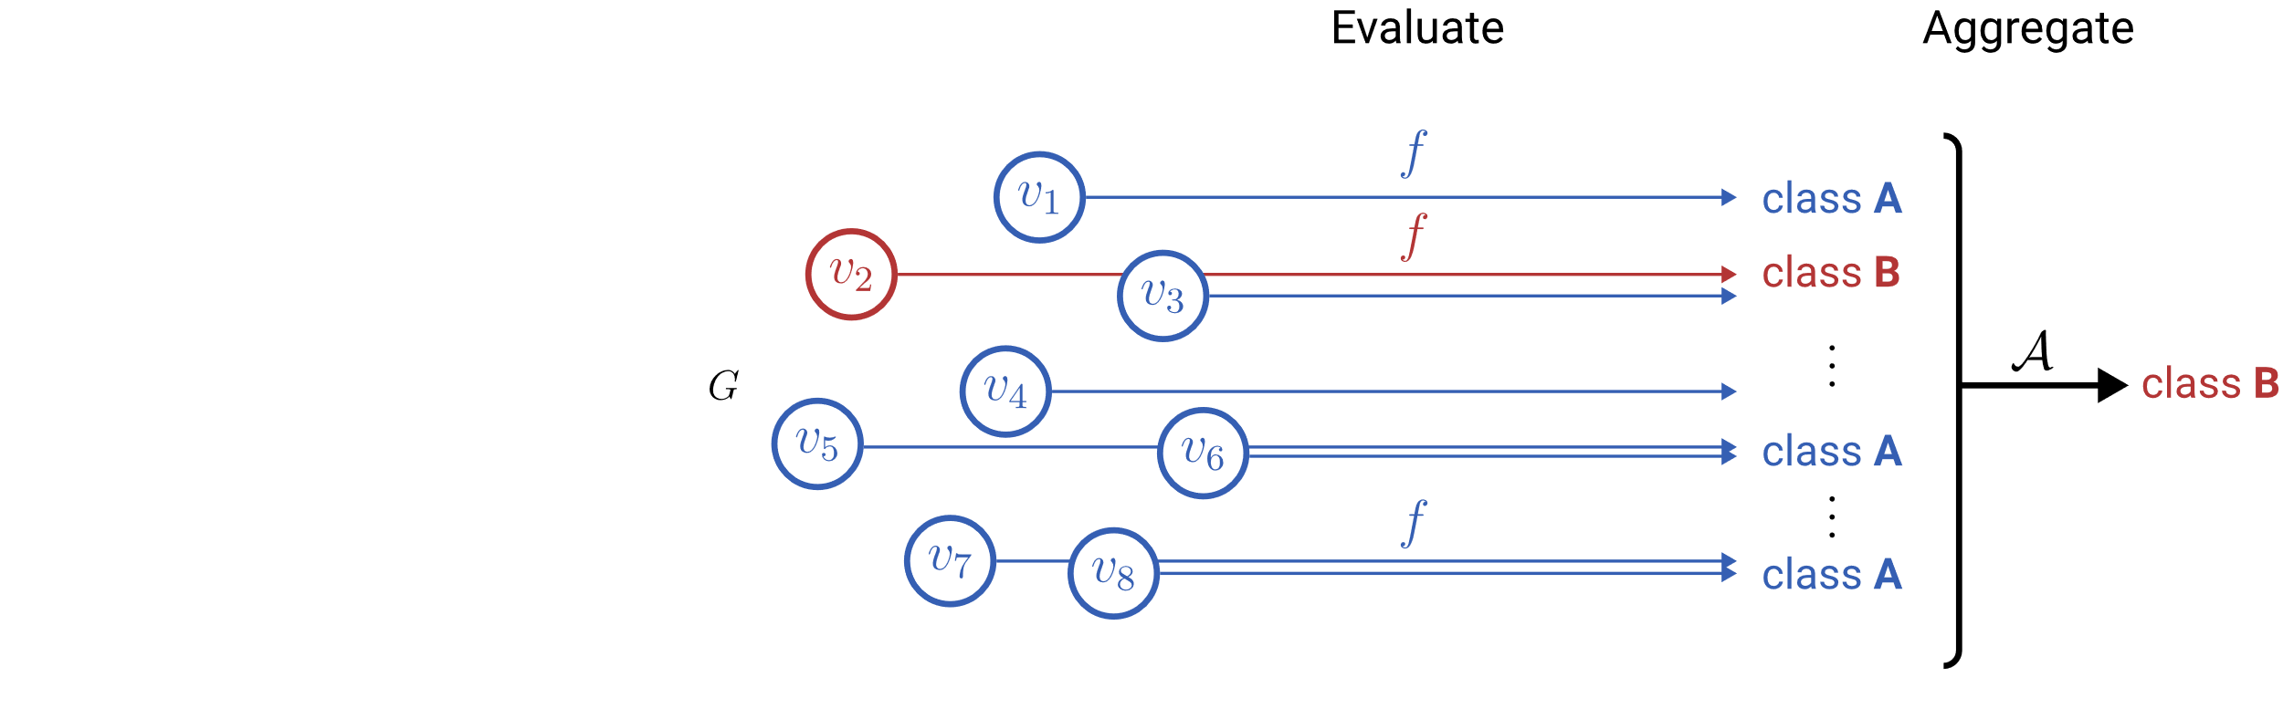

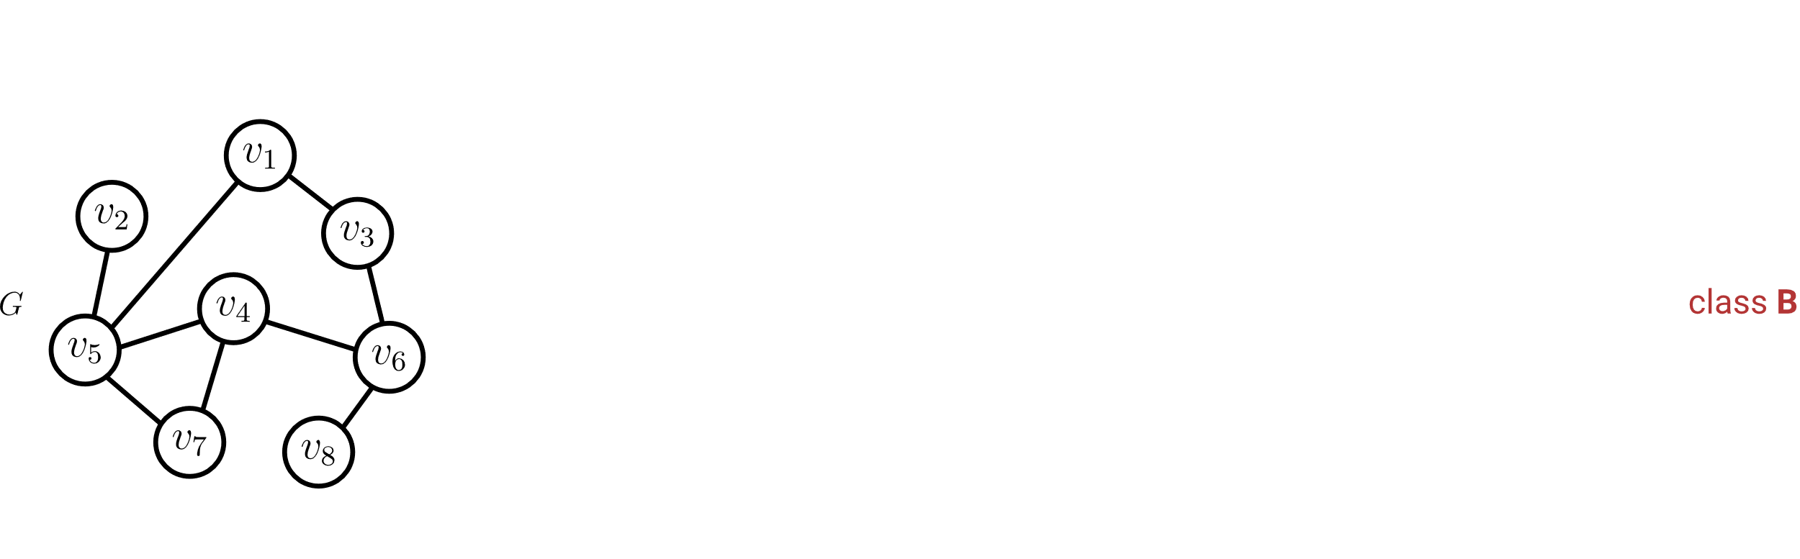
Learning to Aggregate on Structured Data
Permutation invariance
Variable input size
Localized explainability
Vertex constituents do not use structure.

Slide 4
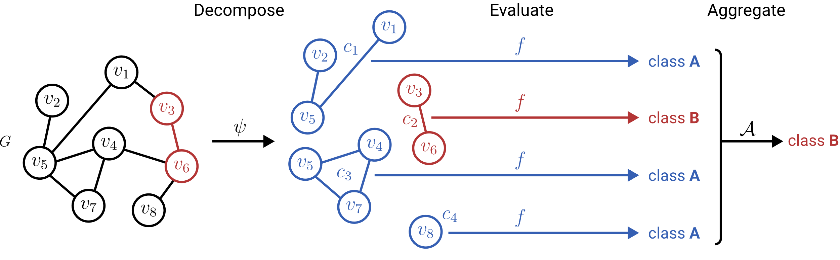
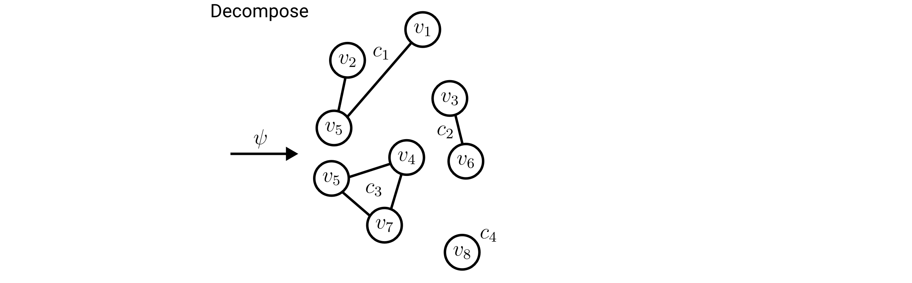
Learning to Aggregate on Structured Data
Permutation invariance
Variable input size
Localized explainability

Slide 5
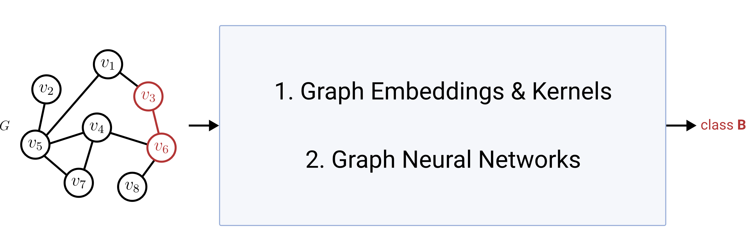
Graph Classification & Regression (GC/GR)
Permutation invariance
Variable input size
Localized explainability
ü
ü
?
Classification/Regression

Slide 6
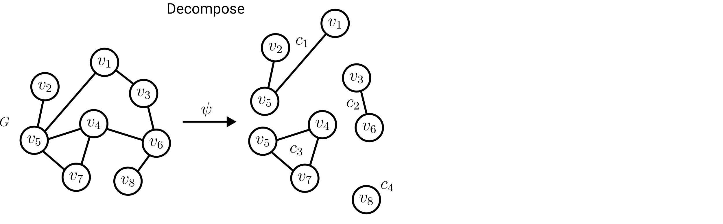
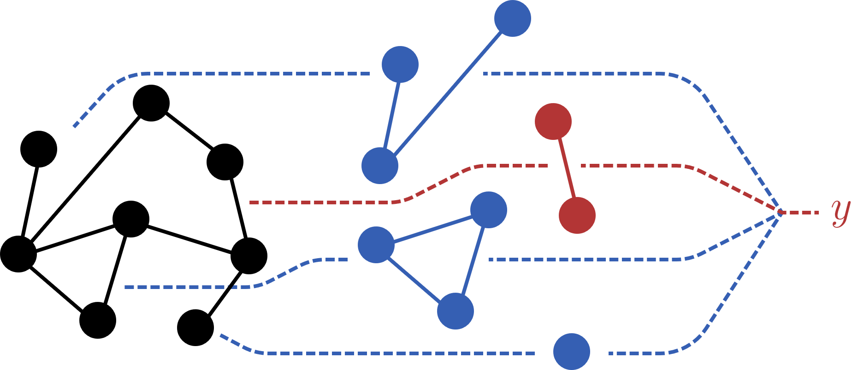
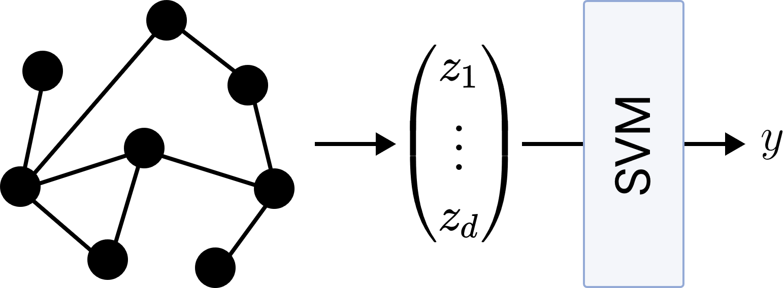
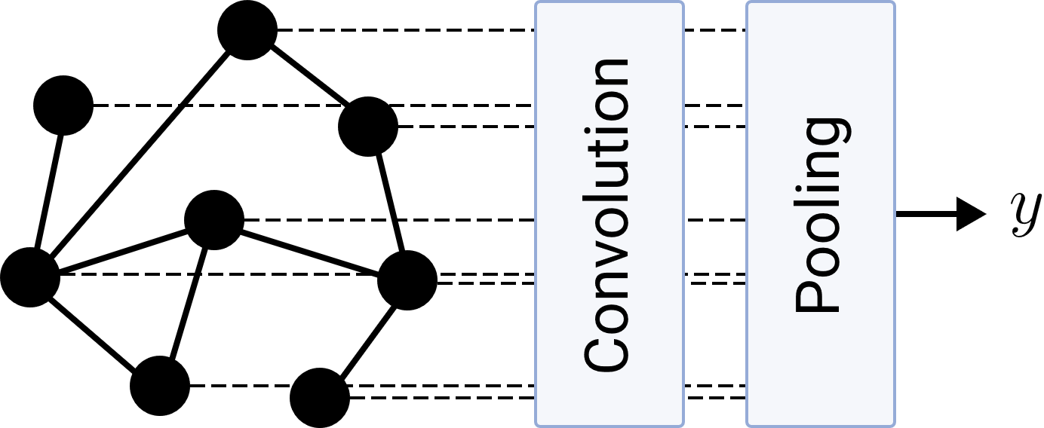
Research Questions
LTA
What is a general definition of LTA?
How does LTA relate to existing GC/GR methods?
What are shortcomings of existing GC/GR methods? How can they be fixed?
Graph Embeddings & Kernels
Graph Neural Networks

Slide 7

Definition of LTA: Decomposition
Ideally: Localized, interpretable subgraph constituents
Required:
Split a graph into a subset of its subgraphs

Slide 8
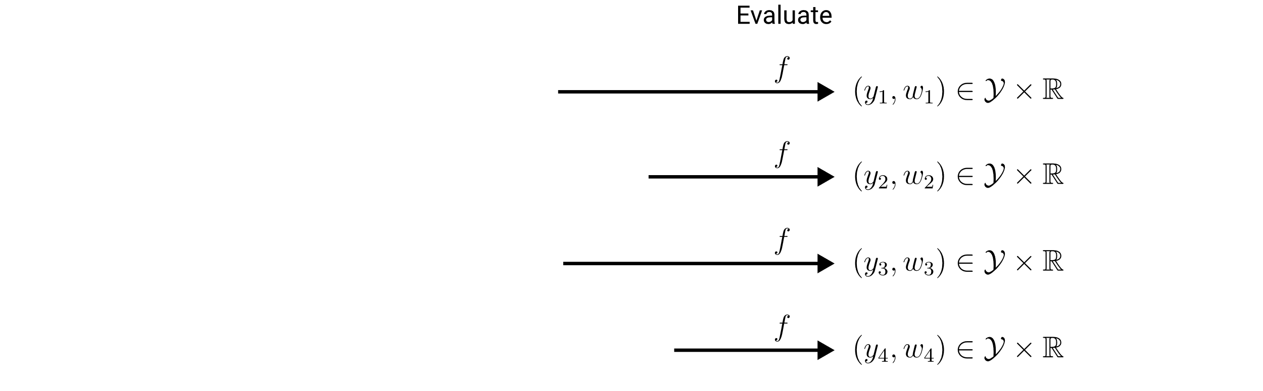
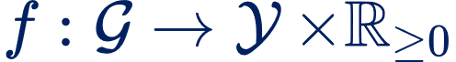
Definition of LTA: Evaluation
Importance for the composition score.
Required:
Assign a score and weight to each constituent

Slide 9

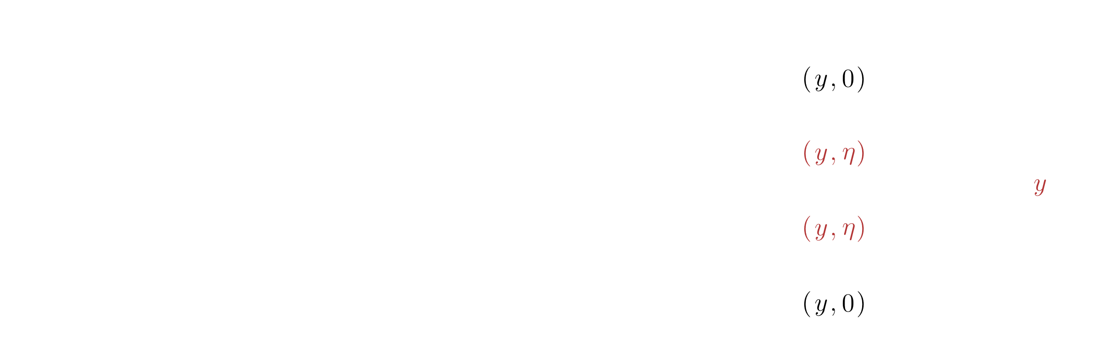
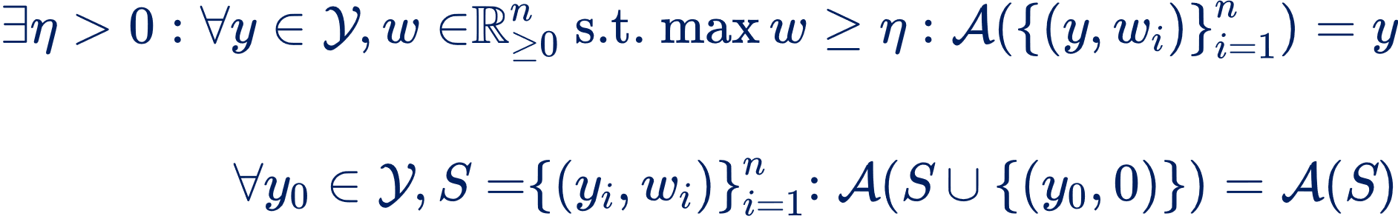
Definition of LTA: Aggregation
Idempotency:
Zero invariance:

Slide 10
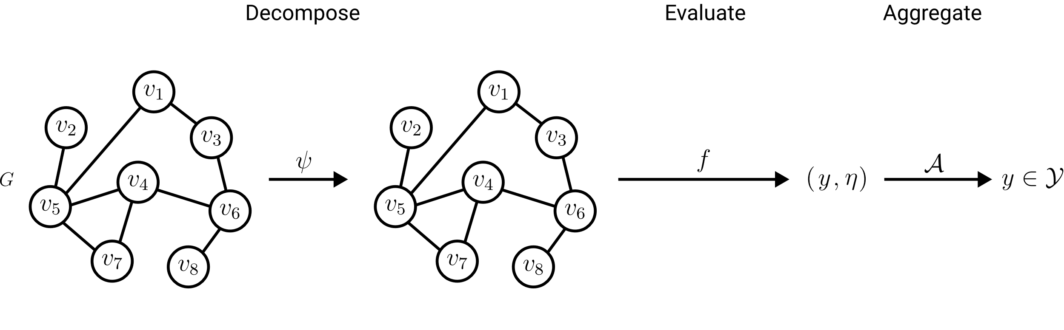

Definition of LTA: Formulations
Trivial decomposition
LTA Formulation

Slide 11
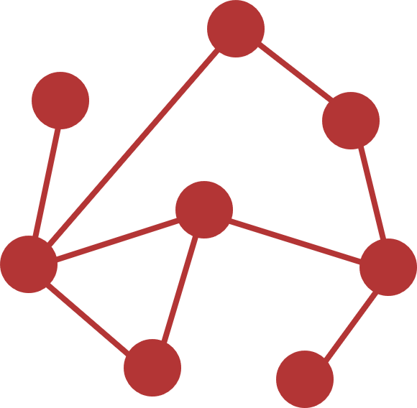

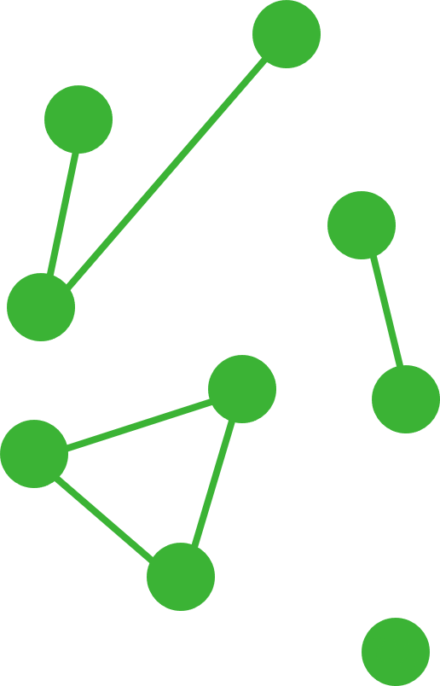
Definition of LTA: LTA vs non-LTA
non-LTA
One trivial global constituent
LTA-like
Connected component constituents
Localized Explainability
LTA-like
Localized constituents of limited size
LTA
Meaningful localized constituents

Slide 12
Research Questions
LTA
What is a general definition of LTA?
How does LTA relate to existing GC/GR methods?
What are shortcomings of existing GC/GR methods? How can they be fixed?
?
?
Graph Embeddings & Kernels
Graph Neural Networks

Slide 13
Existing GC/GR Approaches
Graph Embeddings & Kernels
Graph Neural Networks
Theoretical foundations:
Spectral Graph Theory
Weisfeiler-Lehman Colorings

Slide 14
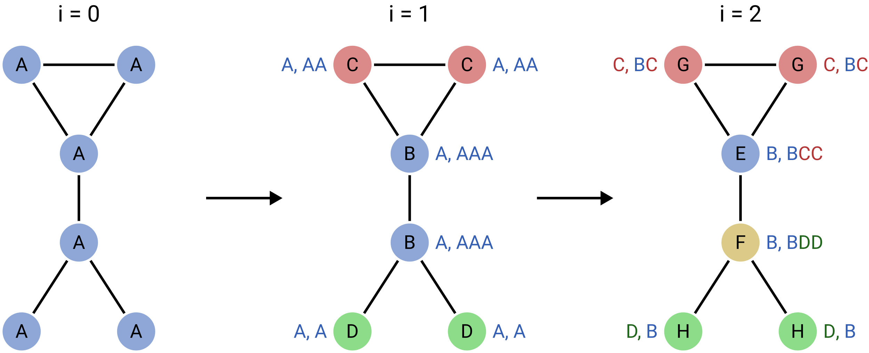

1-Dimensional Weisfeiler-Lehman Colorings
Core Idea: Characterize graphs via multisets of colors.
G
E
G
F
H
H
Refinement:

Slide 15
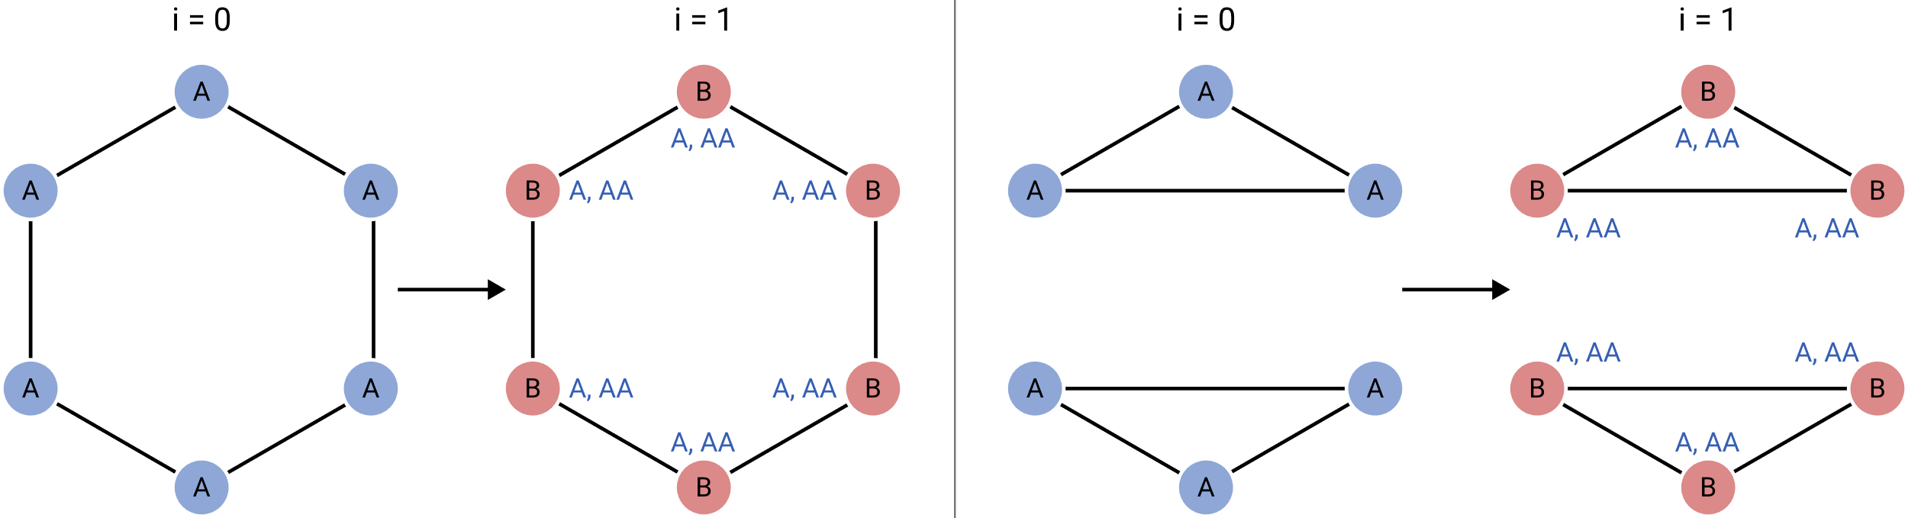
1-Dimensional Weisfeiler-Lehman Colorings
Limitations of 1-WL: Regular graphs & cycle detection

Slide 16
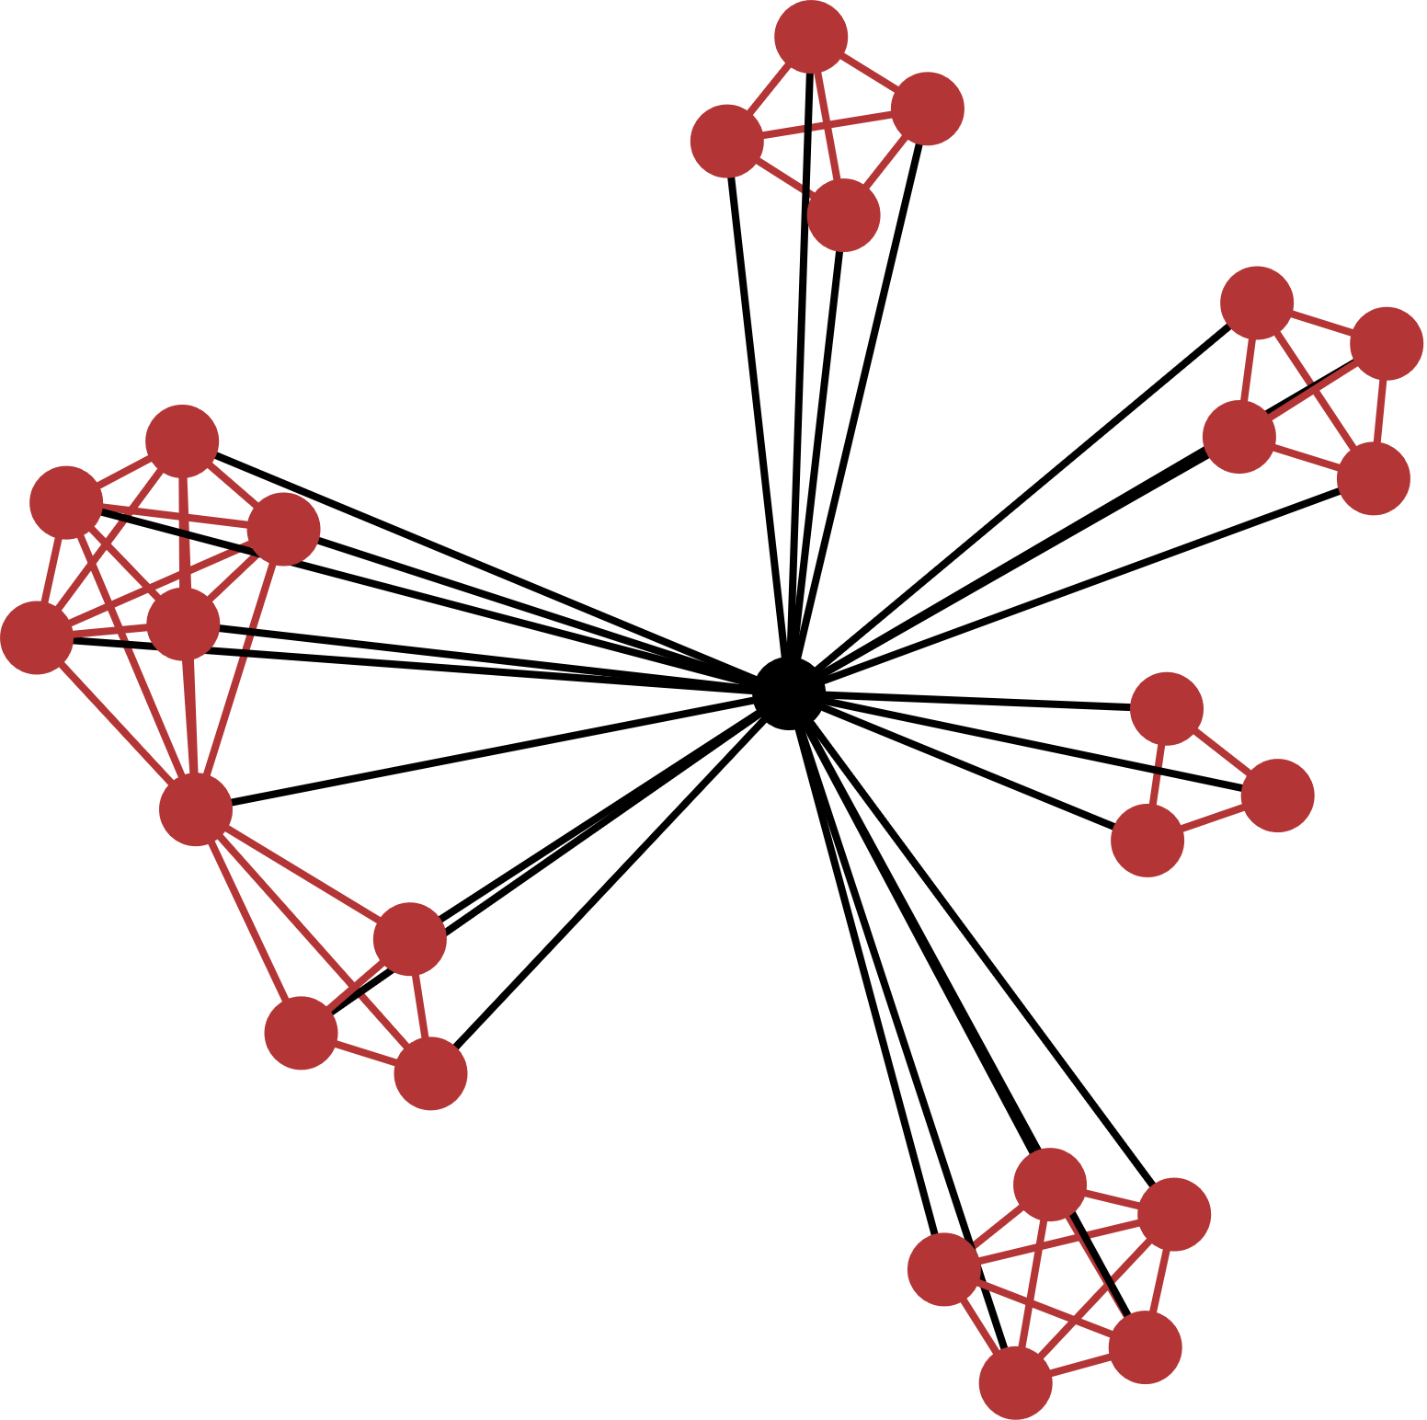
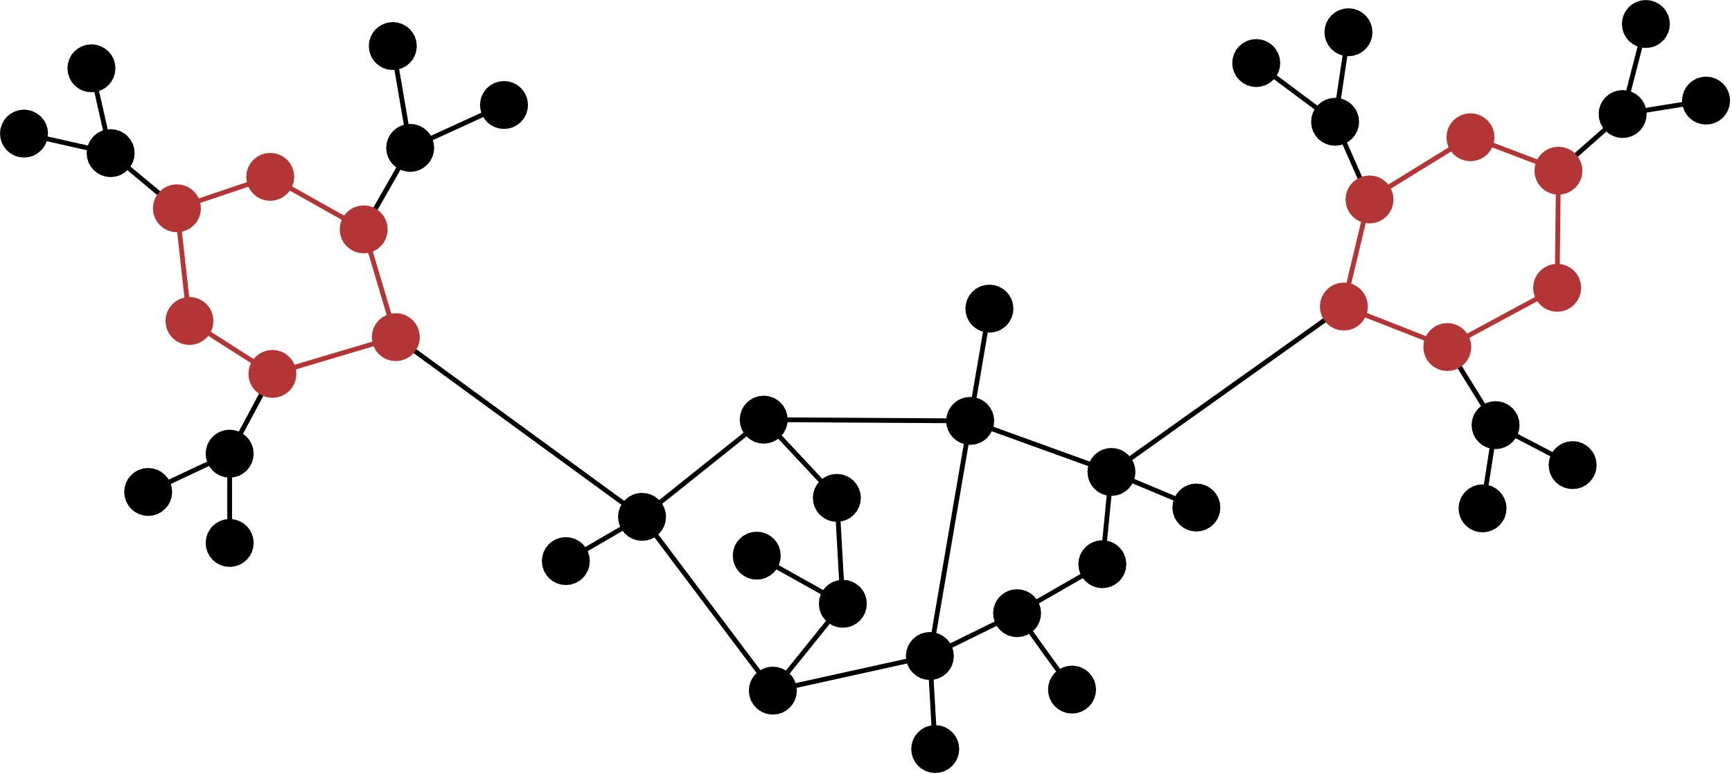

1-Dimensional Weisfeiler-Lehman Colorings
Limitations of 1-WL: Regular graphs & cycle detection
Molecules: Carbon rings
Social networks: Clustering coefficient
$∝$ triangle count

Slide 17
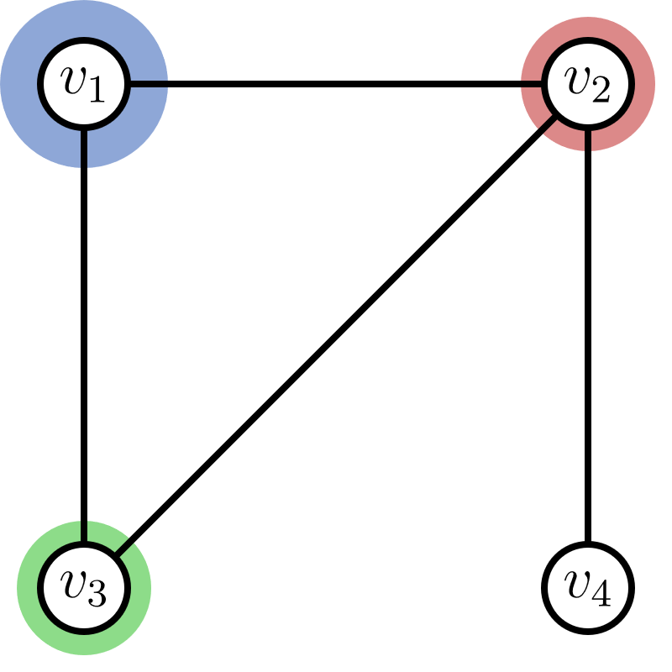
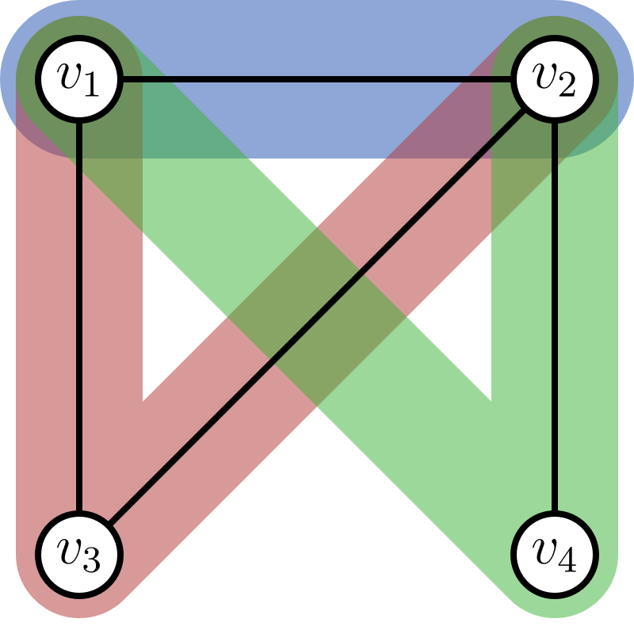
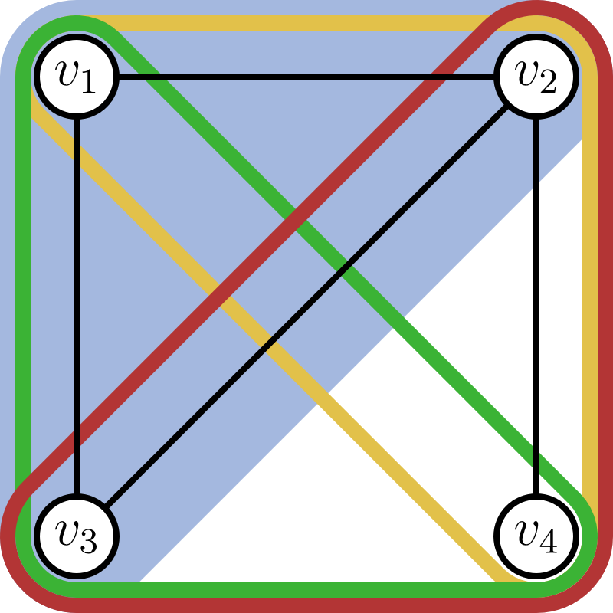


$k$-Dimensional Weisfeiler-Lehman Colorings
Discriminative power & runtime cost
1-WL
2-WL
3-WL
vertex colors
vertex pair colors
vertex triple colors
Refinement:

Slide 18
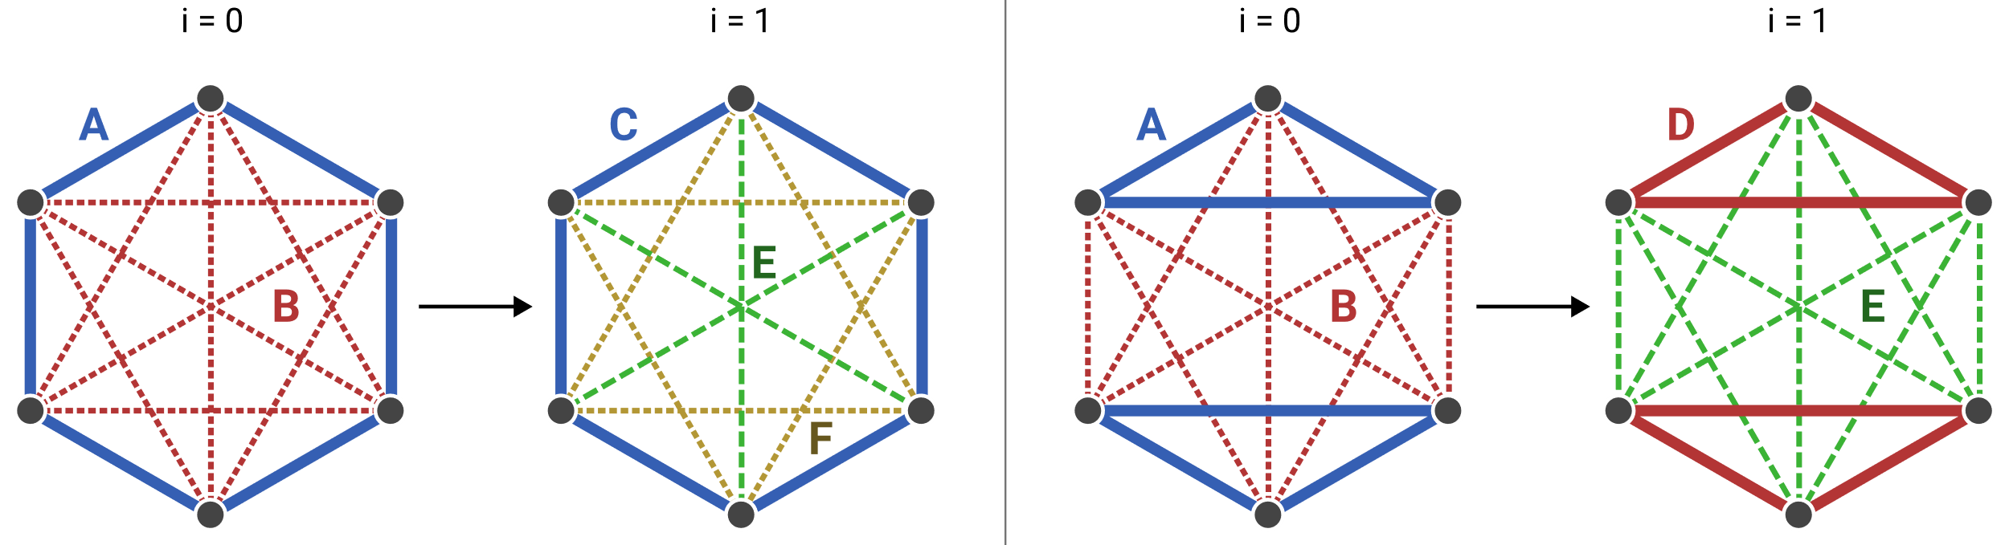
2-Dimensional Weisfeiler-Lehman Colorings
1-WL:
2-WL:

Slide 19

2-Dimensional Weisfeiler-Lehman Colorings
one 6-cycle
two 3-cycles
2-WL can count the number o​f cycles o​f length $≤7$

Slide 20
LTA Formulation of Existing GC/GR Approaches
Graph Embeddings & Kernels
Graph Neural Networks
Theoretical foundations:
Weisfeiler-Lehman Colorings
ü

Slide 21
LTA Formulation of Graph Embeddings & Kernels
Fingerprint embeddings
WL Subtree Kernel
2-LWL kernel
WL subtree kernel
graph2vec
WL shortest-path kernel
2-GWL kernel
…

Slide 22
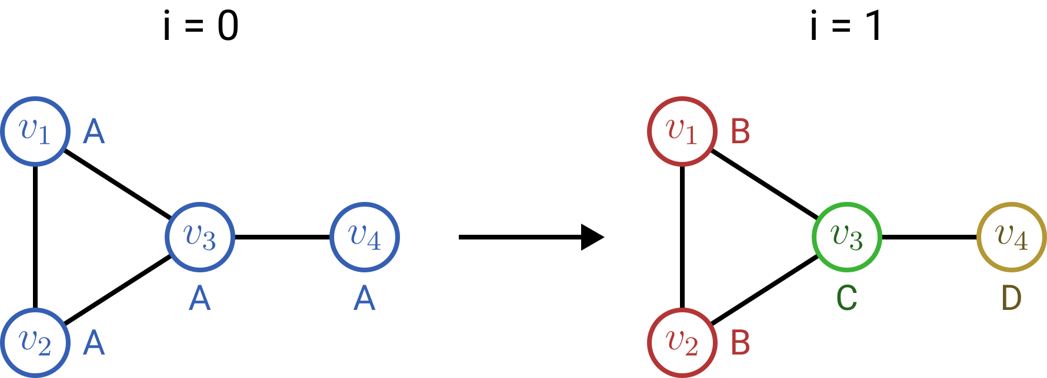
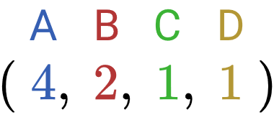
WL Subtree Kernel
1-WL color embedding:

Slide 23
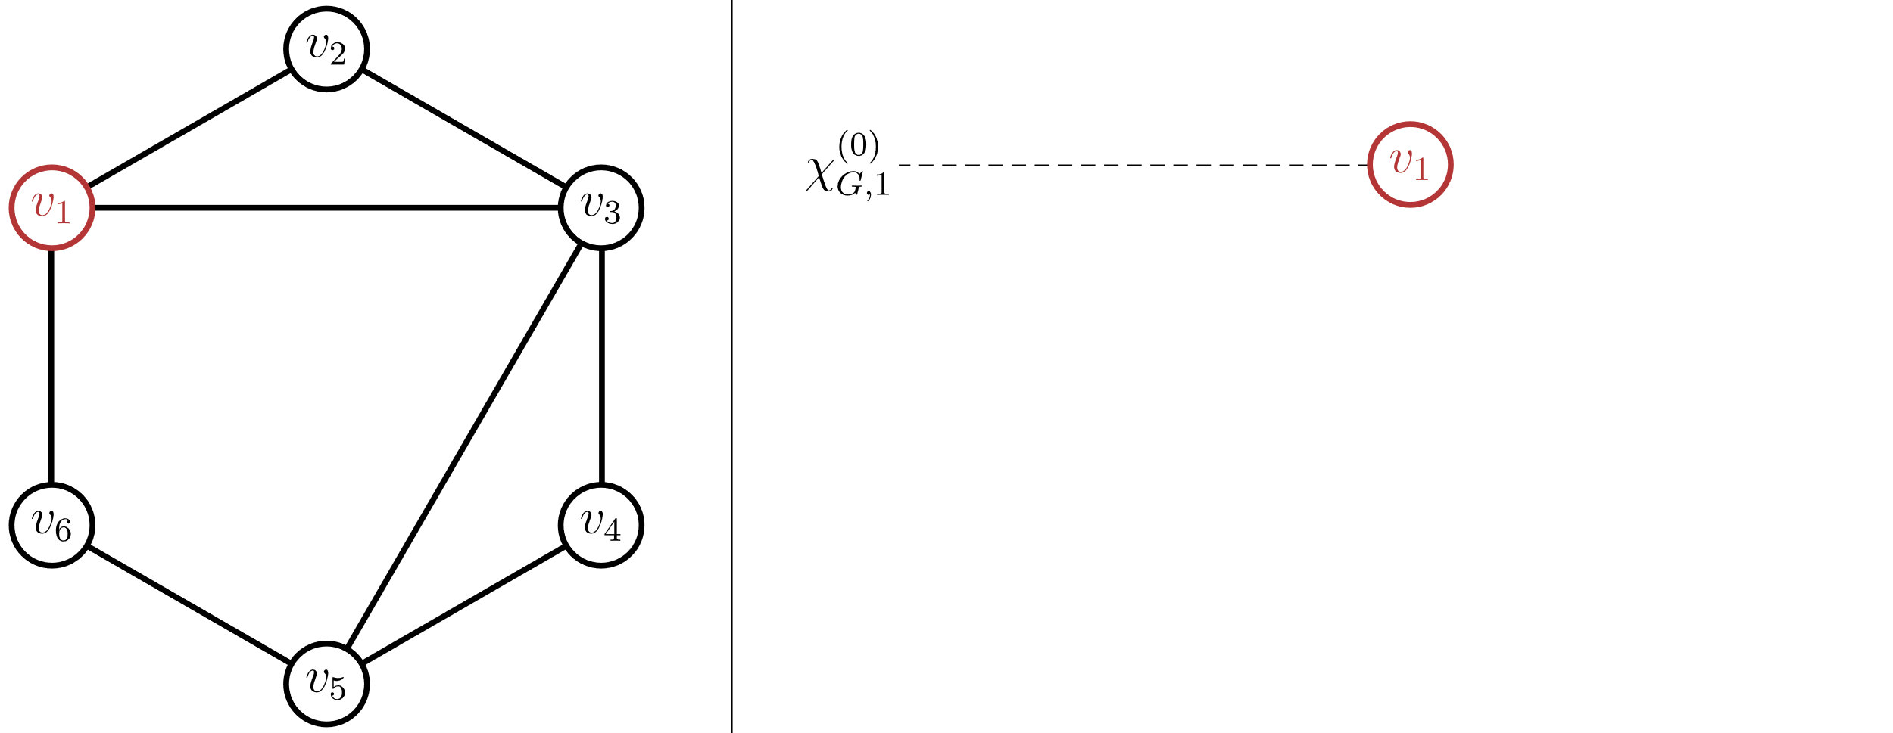
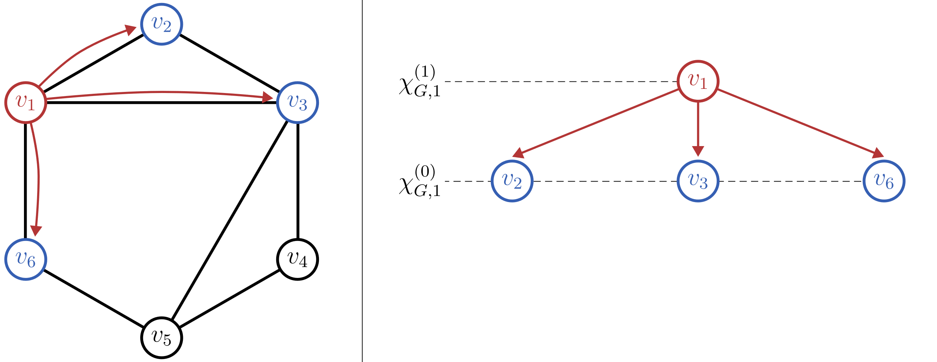
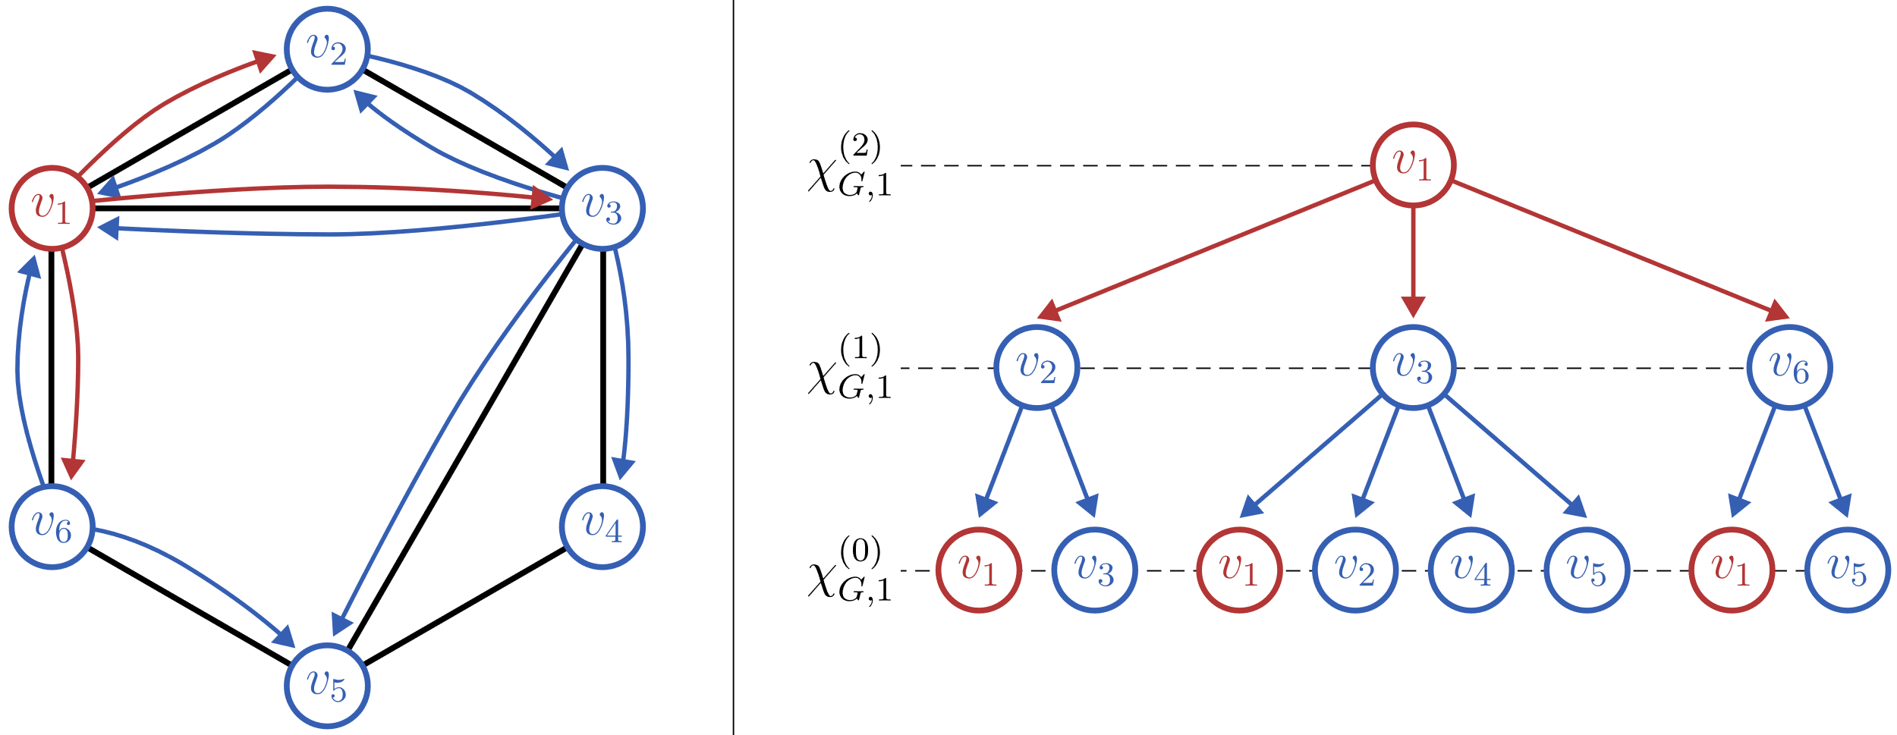
WL Subtree Kernel
Each WL color corresponds to a BFS subtree

Slide 24
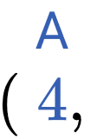


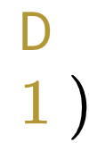
WL Subtree Kernel
1-WL color embedding:

Slide 25
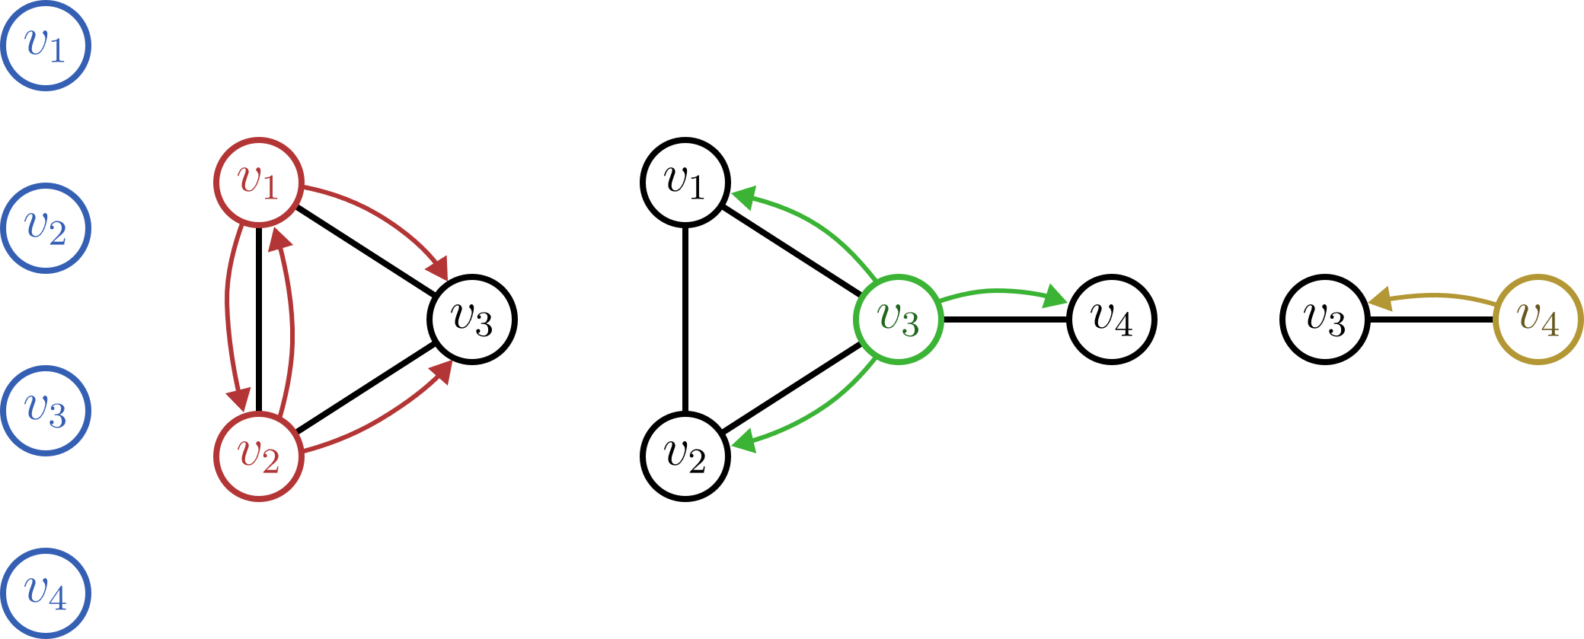
WL Subtree Kernel
1-WL color embedding:

Slide 26
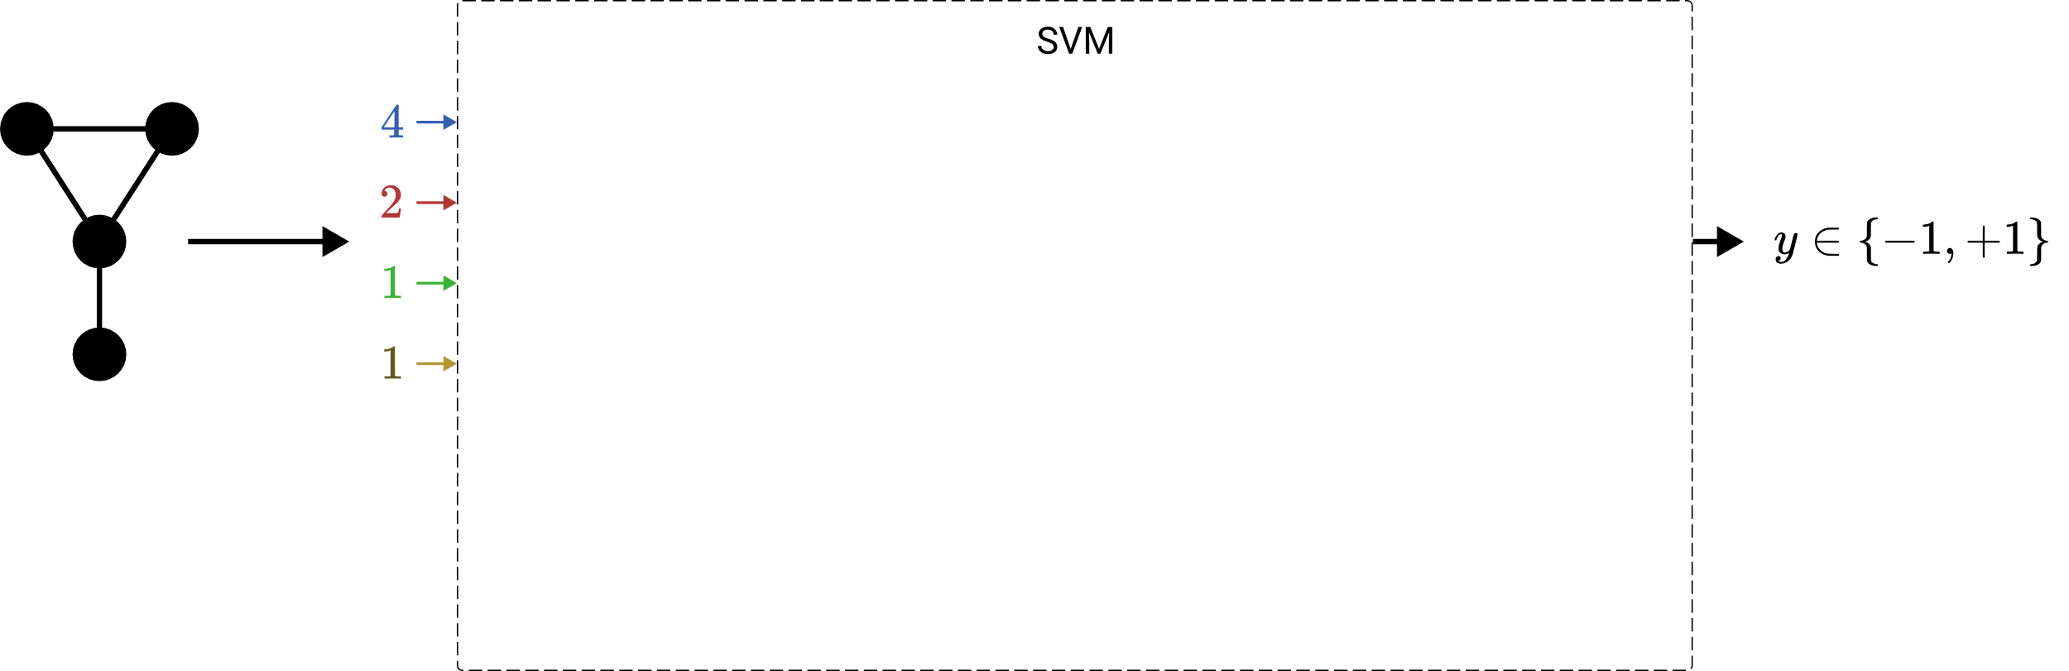
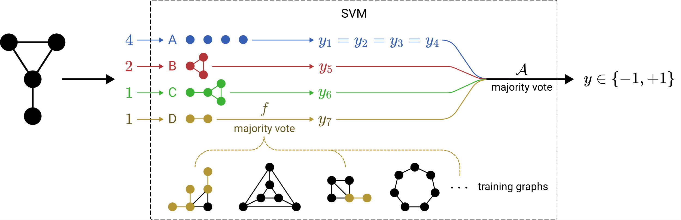

LTA Formulation of Graph Embeddings & Kernels
LTA-like

Slide 27
LTA Formulation of G​raph Embeddings & Kernels
Fingerprint embeddings
2-LWL kernel
LTA-like
Fingerprint embeddings
WL subtree kernel
2-LWL kernel
graph2vec
WL shortest-path kernel
2-GWL kernel
non-LTA
graph2vec
WL shortest-path kernel
2-GWL kernel

Slide 28
Research Questions
LTA
What is a general definition of LTA?
How does LTA relate to existing GC/GR methods?
What are shortcomings of existing GC/GR methods? How can they be fixed?
ü
?
G​raph Embeddings & Kernels
Graph Neural Networks

Slide 29
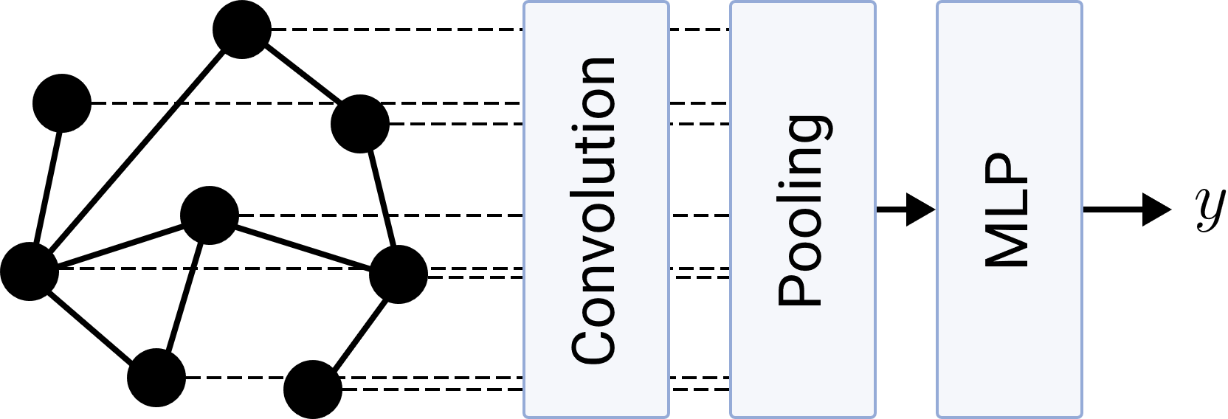
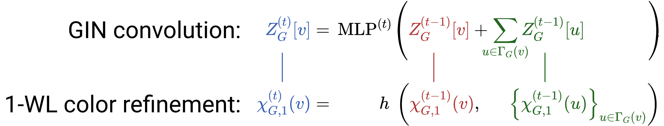
LTA Formulation of Graph Neural Networks
mean
max
self-attention
OWA
…

Slide 30
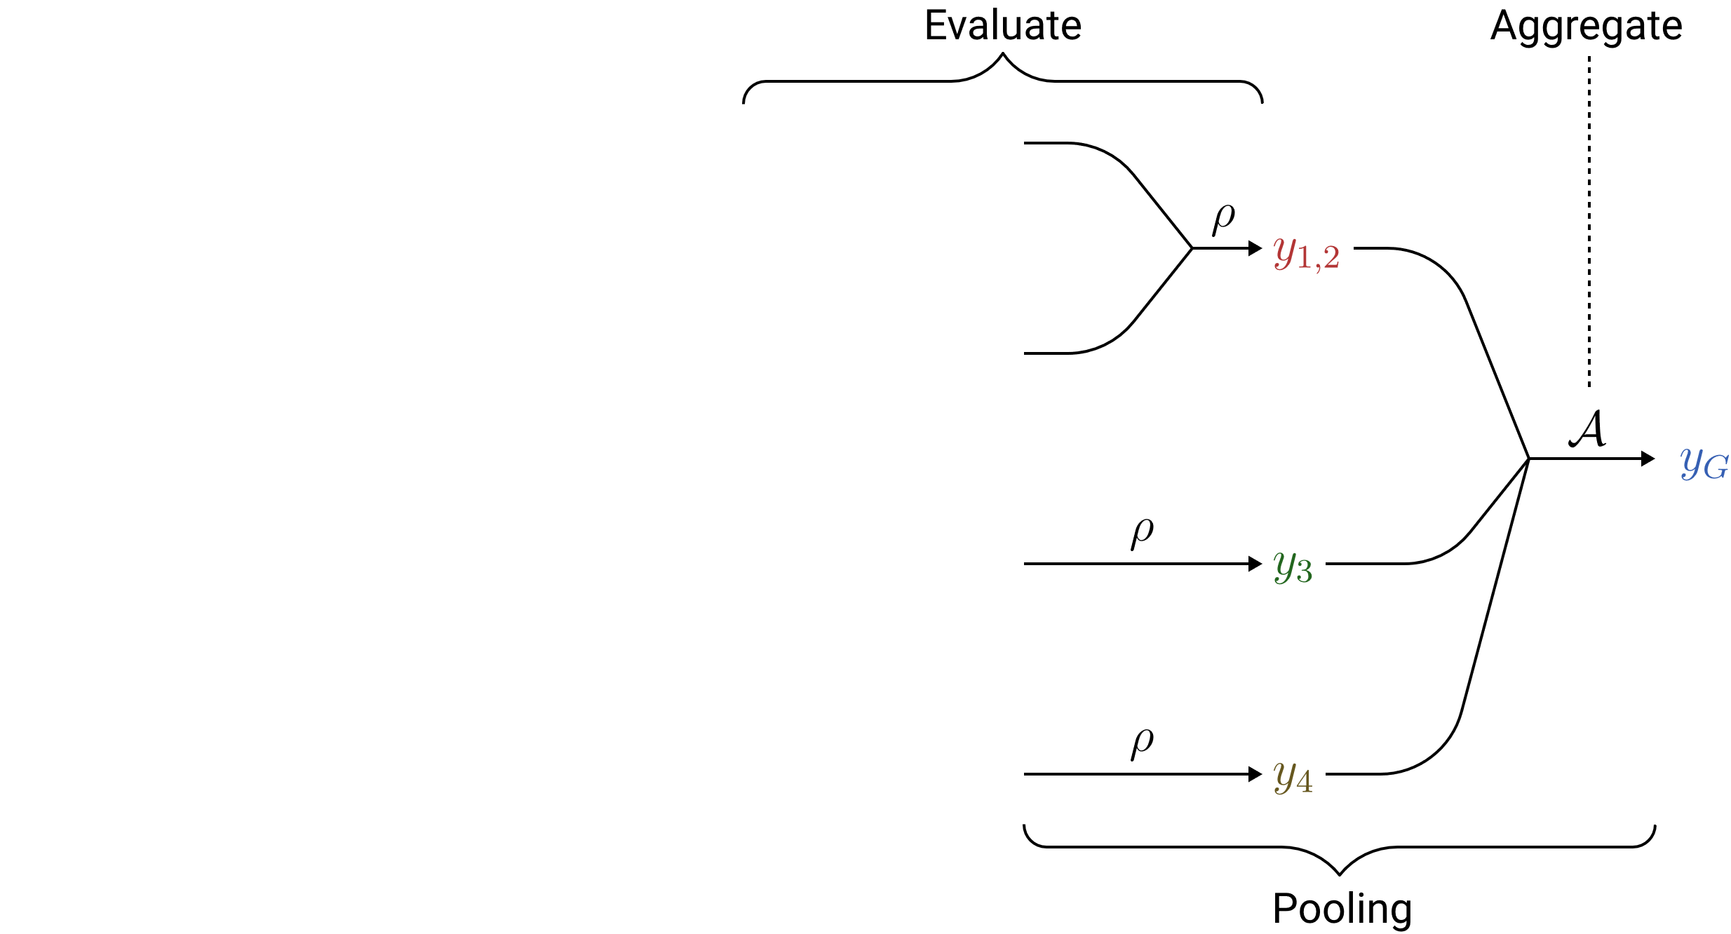
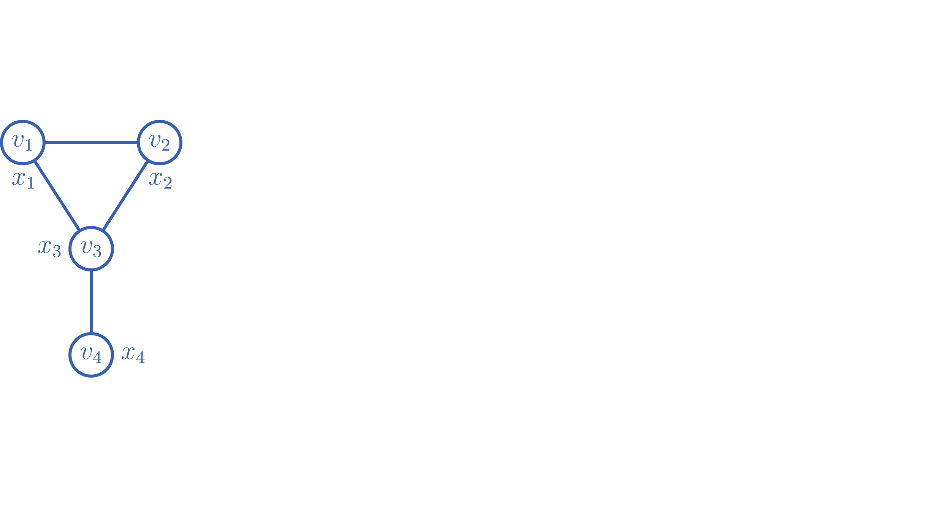
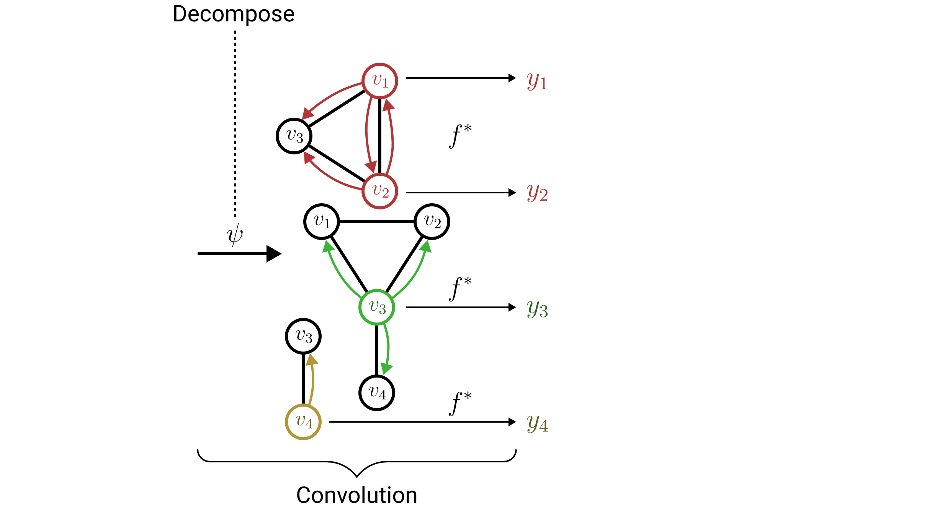
LTA Formulation of Graph Neural Networks
LTA-like
1. Convolution must produce local graph scores
2. Pooling must be associative
e.g. mean or self-attention pooling

Slide 31
Research Questions
LTA
What is a general definition of LTA?
How does LTA relate to existing GC/GR methods?
What are shortcomings of existing GC/GR methods? How can they be fixed?
ü
ü
G​raph Embeddings & Kernels
Graph Neural Networks

Slide 32
Shortcomings of Existing GC/GR Methods
G​raph Embeddings & Kernels
Graph Neural Networks
Embeddings freely determine decomposition
Fixed subtree decomposition
Fixed majority vote evaluation & aggregation
Dynamic MLP-based evaluation
& freely choosable aggregation

Slide 33
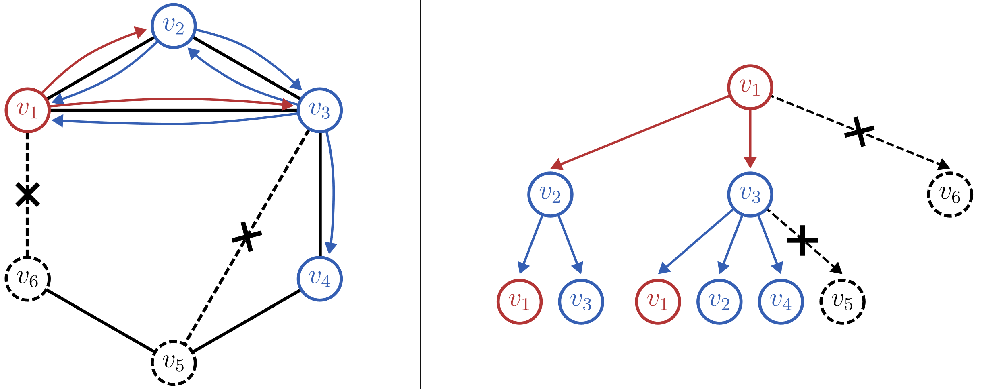
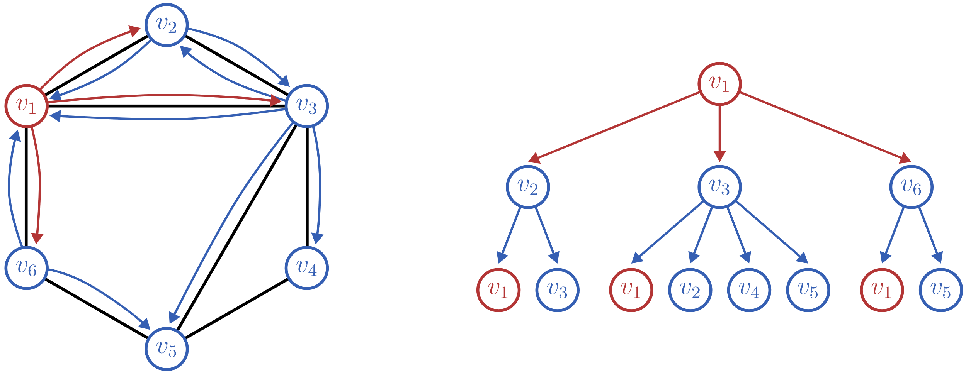
Learning Subtree Constituents
Idea: Prune subtrees via edge filtering

Slide 34
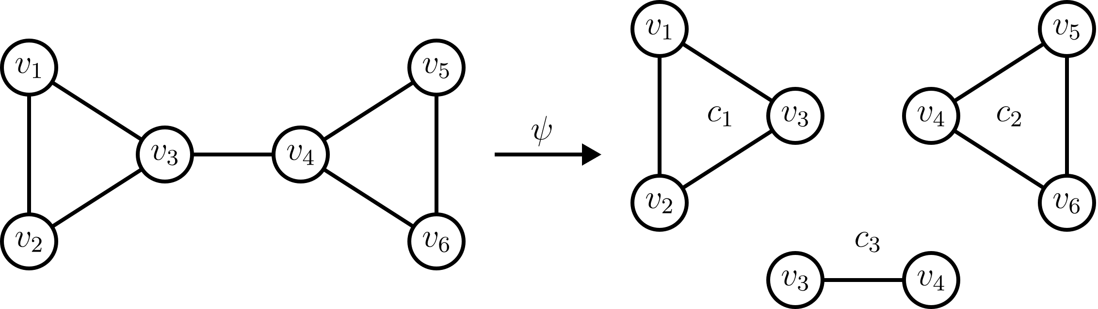
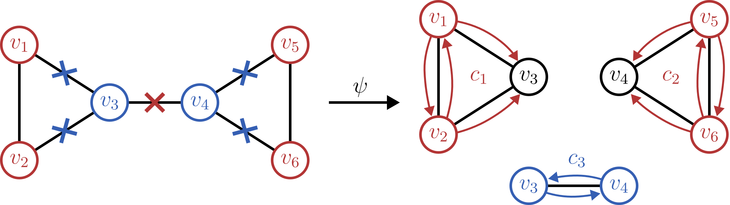
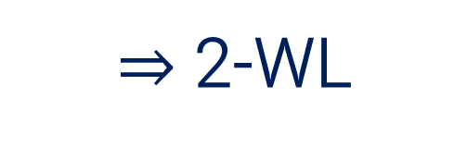
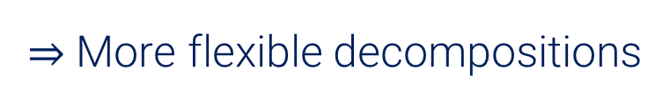
Learning Subtree Constituents
Edge filter requires informative edge feature vectors
$⇒$ 2-WL
$⇒$ More flexible decompositions

Slide 35
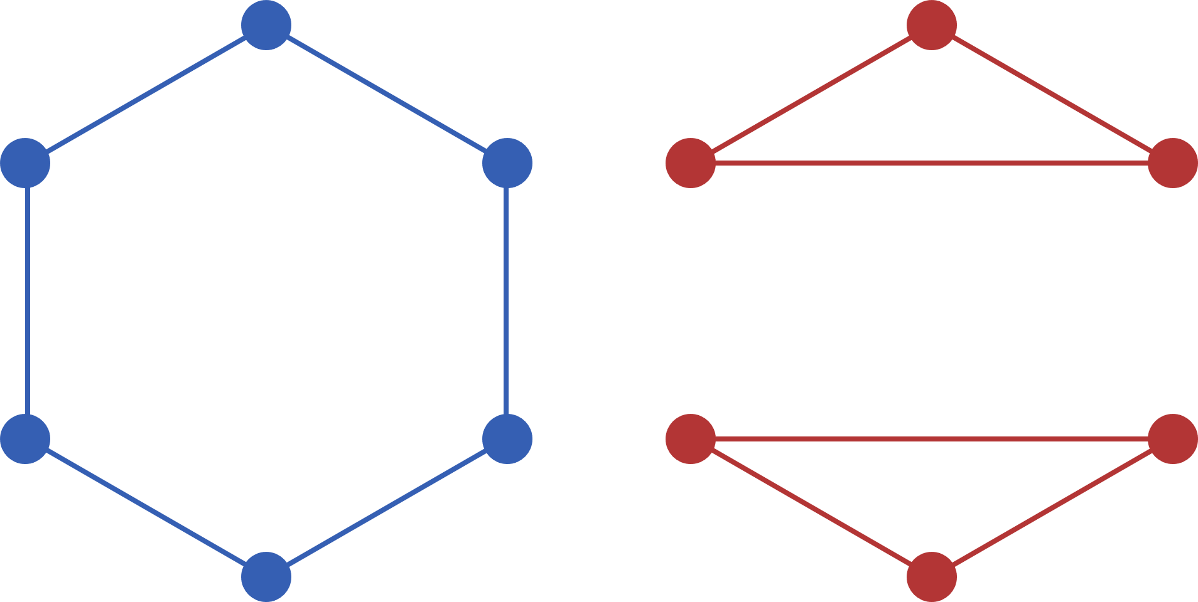
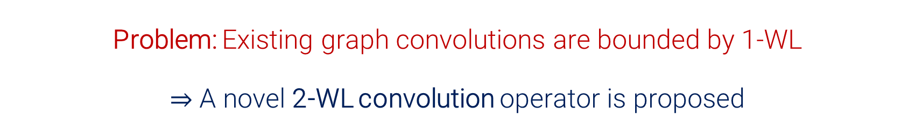
A 2-WL Inspired Convolution Operator
Problem: Existing graph convolutions are bounded by 1-WL
$⇒$ A novel 2-WL convolution operator is proposed
LTA Motivation:
Flexible decompositions
General Motivation:
Discriminative & computational power
& cycle detection
regular graphs

Slide 36




A 2-WL Inspired Convolution Operator
2-WL
One color per vertex pair
neighbors per vertex pair
time complexity for each refinement
Solution: Simplify refinement using sparsity

Slide 37






A 2-WL Inspired Convolution Operator
neighborhood radius
only existing edges
full 2-WL coloring
refinement complexity
$$≤$$
$$≪$$
max vertex degree

Slide 38



A 2-WL Inspired Convolution Operator
1. Can simulate the existing 1-WL bounded GNNs
$⇒$ 1-WL-GNNs $⊂$ 2-WL-GNNs
2. Higher discriminative & computational power than 1-WL

Slide 39
A 2-WL Inspired Convolution Operator
2-WL-GNNs are a starting point for the
2-WL-GNNs provide a solution for the
LTA Motivation:
Flexible decompositions
General Motivation:
Discriminative & computational power
& cycle detection

Slide 40
Research Questions
LTA
What is a general definition of LTA?
How does LTA relate to existing GC/GR methods?
What are shortcomings of existing GC/GR methods? How can they be fixed?
ü
ü
G​raph Embeddings & Kernels
Graph Neural Networks

Slide 41

Evaluation
Comparison of LTA-like methods
with non-LTA methods
vs
Comparison of 1-WL bounded GNNs
with 2-WL-GNNs

Slide 42


Evaluation: Triangle Detection
Goal: Learn to find the unicolored triangle in a noisy graph

Slide 43
Evaluation: Triangle Detection
Goal: Learn to find the unicolored triangle in a noisy graph

Slide 44



Evaluation: Triangle Detection
$⇒$ 2-WL-GNNs have a unique advantage over existing methods
Accuracies and standard deviations across 10-fold train/test splits

Slide 45

Evaluation: Real-World Data
Bioinformatics:
Social networks:

Slide 46


Evaluation: Real-World Data
Accuracies and standard deviations across 10-fold train/test splits

Slide 47



Evaluation: Constituent Locality
$⇒$ The optimal subtree constituents are localized
mean graph radius $=7±2.8$
Accuracy of the WL subtree kernel SVM

Slide 48
Evaluation: 2-WL Neighborhood Radius
How does the neighborhood radius relate to classification accuracy?

Slide 49

Evaluation: 2-WL Neighborhood Radius
Accuracy of the LTA-like 2-WL-GNN

Slide 50





Evaluation: 2-WL Neighborhood Radius
Influenced by neighborhood radius:
Neighborhood radius invariant:

Slide 51

Evaluation: 2-WL Neighborhood Radius
Influenced by neighborhood radius:
Neighborhood radius invariant:
Cyclic graph datasets
List- or tree-like graph datasets
Hypothesis:
2-WL-GNNs can utilize cyclic constituents in real-world problems if $r>1$.

Slide 52

Recap
LTA
G​raph Embeddings & Kernels
2-WL-GNN
Graph Neural Networks
Edge Filtering

Slide 53
Future Directions
LTA
G​raph Embeddings & Kernels
Interpretability of constituent evaluations
2-WL-GNN
Graph Neural Networks
Edge Filtering
Other domains

Slide 54
Questions?

Slide 55
Extra Slides

Slide 56

Dataset Statistics

Slide 57


Intuition for 1-WL Simulation via 2-WL-GNNs

Slide 58


Limitations of 2-GNNs

Slide 59

Accuracy Deltas: Triangle Dataset

Slide 60

Accuracy Deltas: NCI1 Dataset

Slide 61

Accuracy Deltas: REDDIT Dataset

